Slide 1
FastAPI File Management using PostgreSQL, MinIO, and Caching
By: Shrabana Paul
Mentor: Suprava Das
Institution: IDEAS-TIH, ISI Kolkata
Internship Duration: Aug–Oct 2025

Slide 2
Abstract
Developed a scalable backend File Management System using FastAPI.
Integrated PostgreSQL for metadata and MinIO for object storage.
Implemented caching with FastAPI-Cache2 for performance.
Supported real-time merging and retrieval of datasets.
Ensures automation, reliability, and modular design.

Slide 3
System Architecture / Workflow
FASTAPI FILE MANAGEMENT SYSTEM
User ─▶ FastAPI API Layer ─▶ PostgreSQL (Metadata) ─▶ MinIO (File Storage)
│
▼
Pandas Merge ─▶ FastAPI Cache (Temporary)
│
▼
Save Merged File ─▶ MinIO (Final Storage) + PostgreSQL (Updated Metadata)

Slide 4
Introduction
Organizations face challenges in handling large datasets.
FastAPI + PostgreSQL + MinIO + Caching = Efficient backend for data ingestion.
Simplifies ETL workflows with modular, microservice-based design.
Project Objectives
Develop API-driven file management system.
Integrate FastAPI, PostgreSQL, and MinIO.
Implement caching for merged datasets.
Automate data merging & validation.
Ensure scalability & reproducibility.

Slide 5
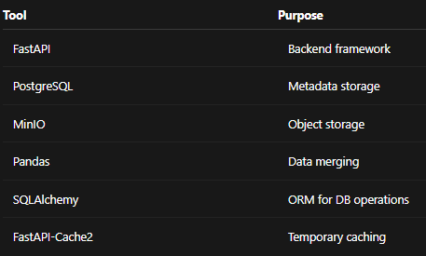
Methodology and tools used

Slide 6
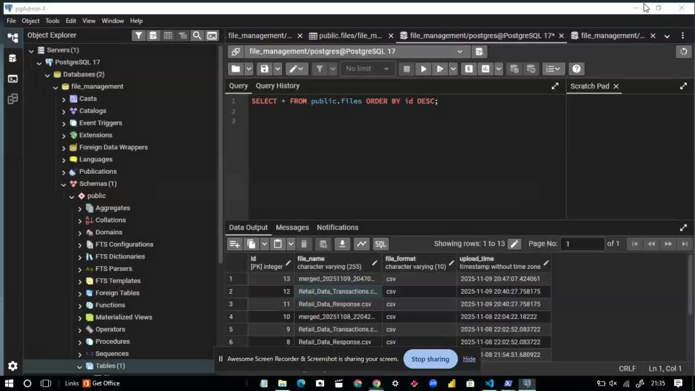
Execution of the program

Slide 7
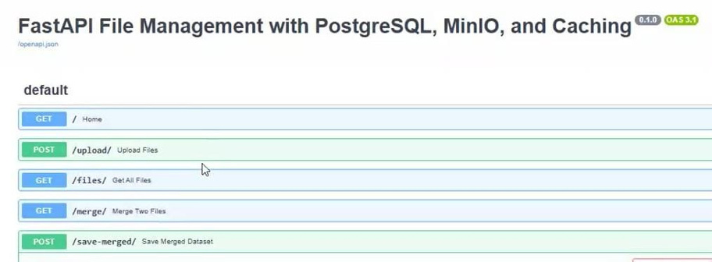
API Testing Environment
Swagger UI showing all FastAPI endpoints.

Slide 8

File Upload Verification
Uploaded files stored with metadata in PostgreSQL.

Slide 9
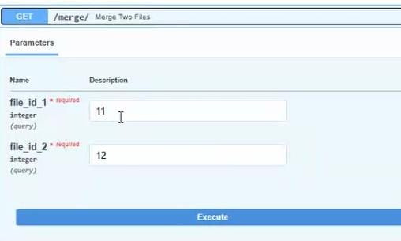
Merge Endpoint
File IDs 11 and 12 selected for merging.

Slide 10
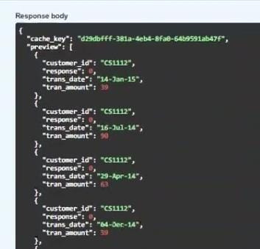
Cached Merge Preview
FastAPI returns preview of merged cached dataset.

Slide 11

Save Merged Dataset
Merged dataset saved successfully to MinIO.

Slide 12
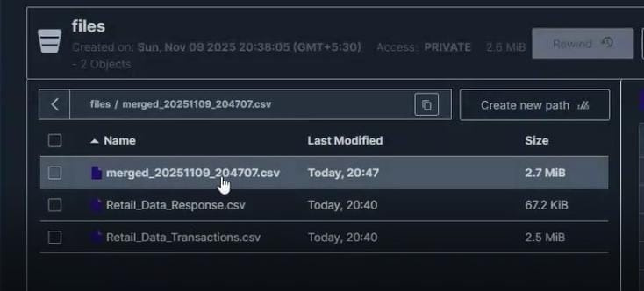
Final Files in MinIO
MinIO storage shows merged and raw datasets.

Slide 13
Resullts
RESULTS
• All FastAPI endpoints (/upload/, /files/, /merge/, /save-merged/)
executed successfully through Swagger UI.
• Uploaded datasets were stored correctly in MinIO and their metadata
(ID, filename, format, timestamp) was inserted into PostgreSQL.
• Merge operation (file_id_1 = 11, file_id_2 = 12) executed smoothly:
- Files fetched from MinIO
- Merged via Pandas on `customer_id`
- Preview returned with a unique cache_key
• Cached merged dataset was successfully saved back to MinIO as:
merged_20251109_204707.csv
• PostgreSQL updated with new metadata entry for the merged file.
• Full backend workflow validated end-to-end:
Upload → Retrieve → Merge (Cached) → Save → Verify

Slide 14
References & GitHub
• FastAPI Docs — https://fastapi.tiangolo.com
• MinIO Docs — https://min.io/docs
• PostgreSQL Docs — https://www.postgresql.org/docs
• SQLAlchemy Docs — https://docs.sqlalchemy.org
• GitHub Repo — https://github.com/shrabanapaul9/fastapi_file_manager

